Slide 1
Lines, Lies, and Logic
Making Sense of Code Metrics

Slide 2
What are code metrics?
Code metrics are a set of software measures that provide developers better insight into the code they are developing.
By taking advantage of code metrics, developers can understand which types or methods should be reworked or more thoroughly tested.
Development teams can identify potential risks, understand the current state of a project, and track progress during software development.

Slide 3
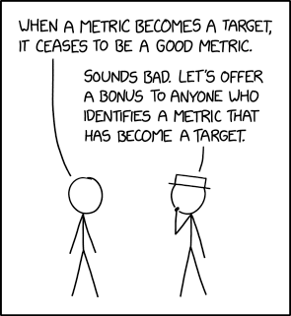
Goodhart’s Law
“Any observed statistical regularity will tend to collapse once pressure is placed upon it for control purposes.” – Charles Goodhart, Problems of Monetary Management: The UK Experience (1975)
“When a measure becomes a target, it ceases to be a good measure.” – Marilyn Strathern (1997)

Slide 4
Warning: This Code Was Written By a Professional. Don’t Try This at Home.
Lines, lies, and logic: Making sense of code metrics

Slide 5
The Requirements
Write an external sort program, with some unit tests. The objective of external sorting is to sort a dataset that does not fit in memory. To manage this problem effectively in a reasonable period of time, this restriction will need to be artificial. Therefore:
Write a program which will write N random 4-byte integers to file (in binary form). Choose N small at first to debug your problem, but it should scale to billions.
Write a program which uses an external merge sort to write a sorted version of the file, using no more than M integers of in-memory capacity to do sorting. Start with a small M -- say three -- and make sure it works up to millions. (When M is larger than N, then the sort is no longer external)
Write a program which reads the sorted file and confirms that it is sorted correctly.
You may use any library functions your language provides for doing the in-memory sort of the M integers, but you must write the external merge sort algorithm yourself.
Can you adjust your program in the following ways, or, if you do not have time, discuss your strategy for addressing?
When data gets large, what will limit the performance of this algorithm? How would you combat it?
Are there parts of the program that can be parallelized? Across what kinds of resources?
Sebastian Good President, Palladium Consulting

Slide 6
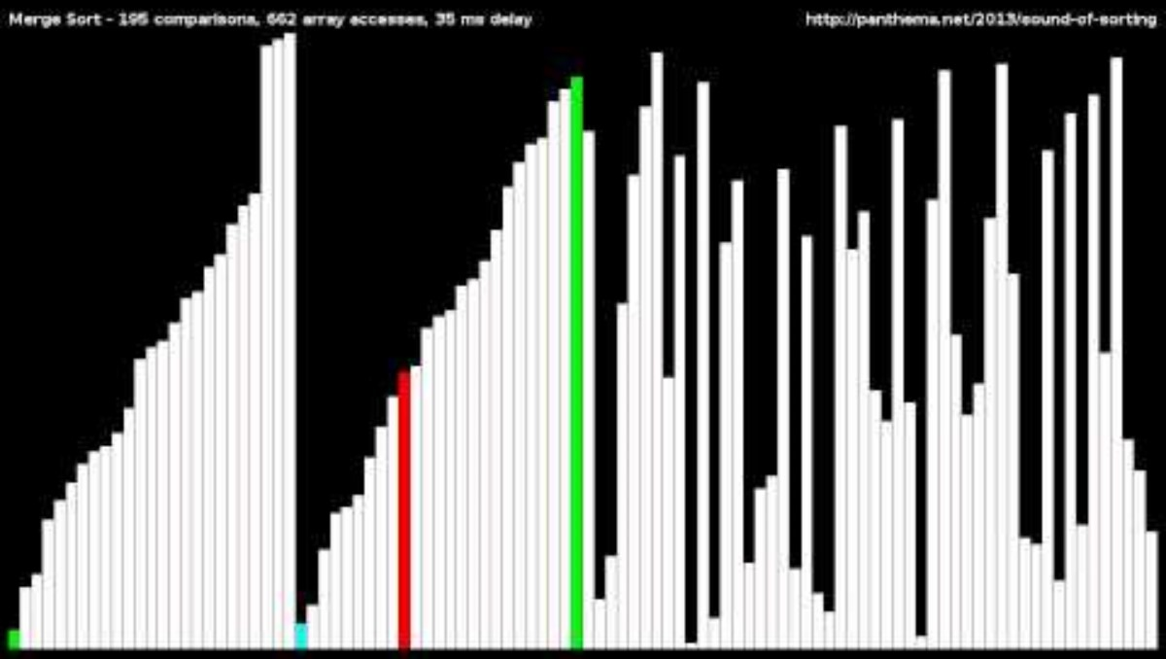
Merge Sort (Visualized)

Slide 7
Lines of Source Code
Lines, lies, and logic: Making sense of code metrics

Slide 8
Lines of Source Code: Size Does Matter (sometimes)
🔍What it is:
Indicates the exact number of source code lines that are present in your source file, including blank lines.
👓How to read it:
Higher number indicates more code
Lower number indicates less code.

Slide 9
Lines of Source Code: Size Does Matter (sometimes)
✅What it can tell you:
Helps identify large files or bloated classes.
❌What it can’t tell you:
Whether or not the code actually works.
🎯Takeaway:
Use it to spot trends, not to judge productivity.

Slide 10
Lines of Executable Code
Lines, lies, and logic: Making sense of code metrics

Slide 11
Lines of Executable Code: Because Size Definitely Doesn’t Tell the Whole Story
🔍What it is:
The number of executable lines in the codebase (i.e. not including comments or whitespace).
Often used as a crude proxy for size or effort.
👓How to read it:
Higher number indicates more executable code
Lower number indicates less executable code

Slide 12
Lines of Executable Code: Because Size Definitely Doesn’t Tell the Whole Story
✅What it can tell you:
Relative size of modules or functions.
When something is likely too large or sprawling.
Helpful for identifying hotspots that may need refactoring.
❌What it can’t tell you:
Code quality, maintainability, or developer productivity.
Whether it’s well-tested, readable, or even correct.
🎯Takeaway:
Use LOC as a signal, not a score. More lines ≠ more value.

Slide 13
Class Coupling
Lines, lies, and logic: Making sense of code metrics

Slide 14
Coupling
🔍What it is:
The degree of interdependence between software modules, a measure of how closely connected two routines or modules are, and the strength of the relationships between modules. Coupling is not binary but multi-dimensional.
2 ways to describe coupling:
Low a.k.a. “loose” or “weak”
High a.k.a. “tight” or “strong”
Low coupling often correlates with high cohesion.

Slide 15
Cohesion
🔍What it is:
The degree to which the elements inside a module belong together.
2 ways to describe cohesion:
High – elements are strongly related, focused on a well-defined purpose
Low – elements are loosely related and serve multiple purposes

Slide 16
Class Coupling: When One Class Just Can’t Let Go
🔍What it is:
A measure of how many classes a class depends on (directly or indirectly).
The more dependencies, the more coupled it is.
👓How to read it:
0 - 5: Low coupling – likely modular and easier to test/reuse
6 - 10: Moderate coupling – may be acceptable depending on class responsibility
11+: High coupling – harder to change/test; could signal a Gawd Class or too much responsibility
Notes:
Measures the coupling to unique classes through parameters, local variables, return types, method calls, generic or template instantiations, base classes, interface implementations, fields defined on external types, and attribute decoration.
Good software design dictates that types and methods should have high cohesion and low coupling.
High coupling indicates a design that is difficult to reuse and maintain because of its many interdependencies on other types.

Slide 17
Class Coupling: When One Class Just Can’t Let Go
✅What it can tell you:
High coupling = more difficult to test, maintain, and reuse.
Useful for spotting design smells like gawd classes, tight integration, or hidden dependencies.
❌What it can’t tell you:
Whether those dependencies are necessary or well-abstracted.
Whether the code is wrong – some tightly coupled code is perfectly valid.
🎯Takeaway:
Low coupling is the dream. High coupling is tech debt with a LinkedIn account.
Notes:
Measures the coupling to unique classes through parameters, local variables, return types, method calls, generic or template instantiations, base classes, interface implementations, fields defined on external types, and attribute decoration.
Good software design dictates that types and methods should have high cohesion and low coupling.
High coupling indicates a design that is difficult to reuse and maintain because of its many interdependencies on other types.

Slide 18
Depth of Inheritance
Lines, lies, and logic: Making sense of code metrics

Slide 19
Depth of Inheritance: Your Family Tree, but With More Bugs
🔍What it is:
The number of inheritance levels from the class to the root of the hierarchy (usually Object).
Measures how deep a class sits in the inheritance chain.
👓How to read it:
A low number for depth implies less complexity but also the possibility of less code reuse through inheritance.
A high number for depth implies more potential for code reuse through inheritance but also higher complexity with a higher probability of errors in the code.
Notes:
Think of it as the number of ancestors you have to read before you understand your code.
"the maximum length from the node to the root of the tree” - S.R. Chidamber and C.F. Kemerer (1994) A Metrics Suite for Object Oriented Design IEEE Transactions on Software Engineering, Vol. 20, No. 6
Indicates the number of different classes that inherit from one another, all the way back to the base class. Depth of Inheritance is similar to class coupling in that a change in a base class can affect any of its inherited classes.
The higher this number, the deeper the inheritance and the higher the potential for base class modifications to result in a breaking change.
For Depth of Inheritance, a low value is good and a high value is bad.

Slide 20
Depth of Inheritance: Your Family Tree, but With More Bugs
✅What it can tell you:
High DIT can imply greater reuse, but also greater complexity.
May indicate classes that are too tightly bound to framework logic or fragile base classes.
Deeper trees tend to be harder to understand and test.
❌What it can’t tell you:
Whether inheritance is used appropriately (vs. composition).
Whether the base classes are clean or a mess.
Whether your object model actually makes any sense.
🎯Takeaway:
Favor shallow hierarchies. If you need a scroll bar to trace your class lineage, it’s probably time for a rethink.
Notes:
Think of it as the number of ancestors you have to read before you understand your code.
"the maximum length from the node to the root of the tree” - S.R. Chidamber and C.F. Kemerer (1994) A Metrics Suite for Object Oriented Design IEEE Transactions on Software Engineering, Vol. 20, No. 6
Indicates the number of different classes that inherit from one another, all the way back to the base class. Depth of Inheritance is similar to class coupling in that a change in a base class can affect any of its inherited classes.
The higher this number, the deeper the inheritance and the higher the potential for base class modifications to result in a breaking change.
For Depth of Inheritance, a low value is good and a high value is bad.

Slide 21
Cyclomatic Complexity
Lines, lies, and logic: Making sense of code metrics

Slide 22
Cyclomatic Complexity: How Many Ways Can This Go Wrong?
🔍What it is:
A measure of the number of independent paths through your code.
Calculated based on decision points: if, for, while, switch, etc.
👓How to read it:
Higher numbers are bad
Lower numbers are good
Notes:
"the amount of decision logic in a source code function“ – Arthur H. Watson, Thomas J. McCabe NIST Special Publication 500-235 Structured Testing: A Testing Methodology Using the Cyclomatic Complexity Metric (1996)
“Measures the structural complexity of the code. It is created by calculating the number of different code paths in the flow of the program. A program that has complex control flow requires more tests to achieve good code coverage and is less maintainable.” – Microsoft Learn

Slide 23
Cyclomatic Complexity: How Many Ways Can This Go Wrong?
✅What it can tell you:
Indicates the logical complexity of a method or function.
Higher values often suggest:
More difficult to test (more paths to cover).
More difficult to maintain (more brainpower required).
A need to refactor or split logic.
❌What it can’t tell you:
Whether your code is bad, just complicated.
Whether the logic is well-structured or readable.
Whether a method is complex because of requirements, not bad design.
🎯Takeaway:
Keep it under 10 if you can. When the cyclomatic complexity hits 20+, maybe your function needs therapy.
Notes:
"the amount of decision logic in a source code function“ – Arthur H. Watson, Thomas J. McCabe NIST Special Publication 500-235 Structured Testing: A Testing Methodology Using the Cyclomatic Complexity Metric (1996)
“Measures the structural complexity of the code. It is created by calculating the number of different code paths in the flow of the program. A program that has complex control flow requires more tests to achieve good code coverage and is less maintainable.” – Microsoft Learn

Slide 24
Maintainability Index
Lines, lies, and logic: Making sense of code metrics

Slide 25
Maintainability Index: Because Someone Said ‘Let’s Math Code Quality’
🔍What it is:
A composite metric that tries to quantify how maintainable a piece of code is.
Based on:
Cyclomatic Complexity
Lines of Code
Halstead Volume
(and sometimes comment ratio)
👓How to read it:
Color coded ratings can be used to quickly identify trouble spots in your code.
Green: between 20 and 100 and indicates that the code has good maintainability.
Yellow: between 10 and 19 and indicates that the code is moderately maintainable.
Red: between 0 and 9 and indicates low maintainability.

Slide 26
Maintainability Index: Because Someone Said ‘Let’s Math Code Quality’
✅What it can tell you:
Gives a quick snapshot of overall maintainability.
Useful in dashboards to track regressions in quality over time.
❌What it can’t tell you:
Why the score is low (you’ll have to dig into the components).
Whether the code is readable, documented, or understandable by a human.
Whether it's bad code… or just doing something complex.

Slide 27
Maintainability Index: Because Someone Said ‘Let’s Math Code Quality’
⚙️How it works:
Maintainability Index = MAX(0,(171 - 5.2 * ln(Halstead Volume) - 0.23 * (Cyclomatic Complexity) - 16.2 * ln(Lines of Code)) * 100 / 171)
🎯Takeaway:
MI is a useful thermometer — just don’t forget to check why the patient has a fever.

Slide 28
Code Churn
Lines, lies, and logic: Making sense of code metrics

Slide 29
Code Churn: The Git Blame Game
🔍What it is:
Code churn measures how often code changes over time.
Usually calculated as:
Lines added, modified, or deleted over a time window.
High churn in a short time = instability or lack of clarity.
👓How to read it:
Higher numbers over time suggests instability or lack of clarity
Lower numbers suggest stability and clear purpose

Slide 30
Code Churn: The Git Blame Game
✅What it can tell you:
Volatile areas of your codebase (a signal for technical debt).
Code that’s hard to get right or not well understood.
Areas that may need extra test coverage or a refactor.
❌What it can’t tell you:
Whether changes were necessary or productive.
Whether the churn is due to iteration or indecision.
If it’s being changed by one person or a team with conflicting views.

Slide 31
Code Churn: The Git Blame Game
📈How It’s Tracked
Most tools track churn via:
Git commit history
Pull request diff analysis
Often visualized in:
Heat maps of files by churn level
Developer impact charts
🎯Takeaway
Churn helps you spot code that's noisy — not always broken, but worth a second look.

Slide 32
Code Coverage %
Lines, lies, and logic: Making sense of code metrics

Slide 33
Code Coverage %: Just Because It’s Touched Doesn’t Mean It’s Tested
🔍What is it:
Measures the percentage of code executed by your test suite.
Common types:
Line coverage – how many lines were run
Branch coverage – were all if/else conditions executed?
Path coverage – were all possible execution paths tested?
👓How to read it:
Higher % indicates more of the code is covered by the test suite.
Lower % indicates less of the code is covered by the test suite.

Slide 34
Code Coverage %: Just Because It’s Touched Doesn’t Mean It’s Tested
✅What it can tell you:
Whether your tests are actually exercising your code.
Can reveal unreachable or untested code.
Helps set baselines for test expectations (e.g. 80%+ for core libraries).
❌What it can’t tell you:
Whether the tests are good, meaningful, or assert anything.
If your code is actually correct or bug-free.
Whether you’ve tested edge cases or weird inputs.
🎯Takeaway:
Coverage is a flashlight — it tells you where the darkness is, not if the light’s actually helpful.

Slide 35
Cognitive Complexity
Lines, lies, and logic: Making sense of code metrics

Slide 36
Cognitive Complexity: How Much Brainpower Does This Code Drain?
🔍What it is:
A code readability metric that estimates how difficult code is to understand.
Unlike Cyclomatic Complexity, it considers how nested and mentally taxing the structure is — not just decision points.
Introduced by SonarSource to improve on limitations of Cyclomatic Complexity.
👓How to read it:
Higher values suggest the code is more difficult to understand
Lower values suggest the code is easier to understand

Slide 37
Cognitive Complexity: How Much Brainpower Does This Code Drain?
✅What it can tell you:
Whether code is easy to follow or a brain pretzel.
Helps spot overly nested conditionals, loops, recursion, and unnecessary indirection.
Promotes simpler, flatter, more maintainable code.
❌What it can’t tell you:
If the code is logically correct.
If the complexity is necessary due to the problem domain.
If naming, comments, or design patterns are helping or hurting.

Slide 38
Cognitive Complexity: How Much Brainpower Does This Code Drain?
⚙️How it works:
1 point per control structure (if, for, while, catch, etc.)
+1 point for each level of nesting
+1 point for recursion (instead of loops)
No penalty for multiple boolean conditions in the same if
🎯Takeaway:
Cyclomatic Complexity counts the paths. Cognitive Complexity counts the headaches.

Slide 39
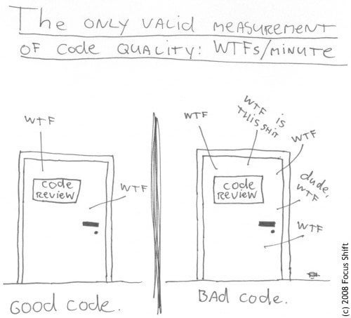
The Only Valid Metric of Code Quality

Slide 40
// TODO:
Collect metrics on your projects
When you roll-on
When you roll-off
The deltas will show you and your teams impact on the codebase over time.
Can be used in your resume
Can be used as a talking point in your interviews

Slide 41
That’s a Metric Wrap!
📏Metrics tell a story—but not the whole story.
🧠Interpret, don’t worship the numbers.
🧰Use metrics to guide decisions, not dictate them.
🎯Focus on trends and context, not snapshots.
😎Your code is more than just numbers—it’s a craft.

Slide 42

How To Contact Me
cardella@gmail.com
www.codegorilla.com
linkedin.com/in/tcardella

Slide 43

Tony Cardella’s Resume

Slide 44
The End

