Slide 1
gRPC + .NET: Lessons From the Trenches

Slide 2
Who is Tony Cardella?
What do you does he do for BJSS?
Software Engineer
Software Engineering Capability Lead (Houston)
What technologies does he work with?
.NET, C#, ASP.NET, REST APIs, gRPC, Entity Framework, Python, JavaScript
SQL Server, SQLite, Azure Cosmos DB, PostgresSQL
Azure, AWS
Email: tony.cardella@bjss.com
LinkedIn: https://www.linkedin.com/in/tcardella/
Blog: https://codegorilla.com

Slide 3
Who is BJSS?
We’re a world-leading technology consultancy that merges strategy, design, delivery and managed service excellence to help you unlock the value of software at every stage of the lifecycle.
Software Engineering
Artificial Intelligence
Data & Insights
Cloud & Platform
Cybersecurity
We have offices in the United States (Houston, New York, Columbus), United Kingdom, Ireland, Portugal, and Australia.

Slide 4
What is gRPC?

Slide 5
What is gRPC?
gRPC is a modern open source high performance Remote Procedure Call (RPC) framework that can run in any environment. It can efficiently connect services in and across data centers with pluggable support for load balancing, tracing, health checking and authentication. It is also applicable in last mile of distributed computing to connect devices, mobile applications and browsers to backend services.
- https://grpc.io/

Slide 6
gRPC vs REST API: Protocol and Data Format
Uses HTTP/2 as the transport protocol.
Typically uses HTTP/1.1 as the transport protocol.
Employs Protocol Buffers (protobuf) for data serialization, which is a binary format.
Commonly uses JSON or XML for data serialization, which are text-based formats.
Supports bi-directional streaming.
Supports request-response communication but not native streaming.

Slide 7
gRPC vs REST API: Performance
Generally faster due to HTTP/2 features like multiplexing, header compression, and binary serialization.
Slower compared to gRPC due to the overhead of text-based serialization (JSON/XML) and HTTP/1.1 limitations.
Lower latency and better performance for high-throughput scenarios.
Suitable for many applications but may not perform as well under high load.

Slide 8
gRPC vs REST API: Time Comparison
N | gRPC Mean | REST Mean
1 | 254.2 | 252.9
10 | 254.5 | 249.3
100 | 250.7 | 247.2
1,000 | 308.4 | 368.1
10,000 | 488.8 | 610.6
100,000 | 820.4 | 986.2
1,000,000 | 2,554.10 | 4,022.30
Client: Conroe, Texas
Server: Azure US West 2 datacenter
gRPC and REST servers are running in separate Azure App Services at the Premium v3 P0V3 level (1vCPU, 4GB ram).

Slide 9
gRPC vs REST API: Message Size Comparison
N | gRPC Average Message Size | RESTAPI Average Message Size
1 | 26.2 | 77.8
10 | 264.6 | 772.6
100 | 2,643.0 | 7,714.5
1,000 | 26,398.6 | 77,152.2
10,000 | 263,743.5 | 771,628.1
100,000 | 2,637,522.9 | 7,715,939.7
1,000,000 | 26,373,544.5 | 77,160,122.1

Slide 10
gRPC vs REST API: Ease of Use and Development
Requires defining service contracts using Protocol Buffers (.proto files).
Easier to get started with, especially for simple CRUD operations.
Provides strong typing and schema validation.
Uses standard HTTP methods (GET, POST, PUT, DELETE).
Automatic code generation for client and server stubs in multiple languages.
No need for additional tools for defining service contracts.

Slide 11
gRPC vs REST API: Interoperability
Supports multiple programming languages through generated code (C/C++, C#, Dart, Go, Java, Kotlin, Node.js, Objective-C, PHP, Python, Ruby).
Highly interoperable and can be consumed by any client that can make HTTP requests.
Not natively supported in web browsers (requires gRPC-Web for browser compatibility).
Natively supported in web browsers.

Slide 12
gRPC vs REST API: Streaming and Real-Time Communication
Supports client-side, server-side, and bi-directional streaming.
Does not natively support streaming.
Suitable for real-time communication scenarios.
Real-time communication typically requires additional technologies like WebSockets.

Slide 13
gRPC vs REST API: Tooling and Ecosystem
Rich ecosystem with tools for code generation, load balancing, and service discovery.
Mature ecosystem with a wide range of tools for testing (e.g., Postman), documentation (e.g., Swagger/OpenAPI), and monitoring.
Requires familiarity with Protocol Buffers and gRPC-specific tools.
Easier to integrate with existing web technologies.

Slide 14
What are Protocol Buffers?

Slide 15
What are Protocol Buffers?
Protocol Buffers are language-neutral, platform-neutral extensible mechanisms for serializing structured data.
- https://protobuf.dev/

Slide 16
What do Protocol Buffers look like?

Slide 17
The Project for an Unnamed Large Oil & Gas Client Located in the Energy Corridor of Houston, Texas

Slide 18
What are we building?

Slide 19
How do you setup your Visual Studio solution?

Slide 20
How are the different projects related?

Slide 21
What does a gRPC endpoint definition look like?

Slide 22
What does the C# code look like?

Slide 23
What does *your* C# code look like?

Slide 24
How do I share Protos across solutions?
A Git submodule is a way to include another Git repository as a subdirectory of your own repository. This is useful when you want to include external code, libraries, or dependencies within your project while keeping them separate from your main codebase.

Slide 25
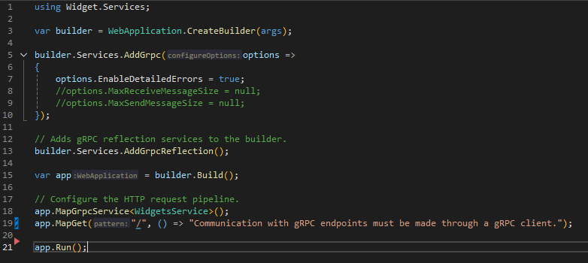
How do I configure dependency injection for gRPC?

Slide 26
Returning Errors / Warnings / Infos

Slide 27
Consider the UpdateWidget gRPC endpoint definition…

Slide 28
Requirement: Validate Widgets Prior to Saving
Requirement: Prior to performing an update on a widget, we need to run the widget in question through an intense validation and return validation errors/warnings/infos.

Slide 29
Bug: ResponseTrailers are exceeding the configured max size
The frontend team is reporting when they try to update a widget, an RpcException gets thrown indicating that the ResponseTrailers are exceeding the configured maximum size for ResponseTrailer (16KB).

Slide 30
How does the implementation for UpdateWidget change?

Slide 31
The Proto-geddon / Proto-colypse

Slide 32
What potential problems do you see with this auto-generated code?

Slide 33
Let’s clear some of the cruft…

Slide 34
How do I know if the request being made is “correct”?

Slide 35
How do I know if the request being made is “correct”?
All input is evil.
– Ken Thompson, creator of the UNIX operating system

Slide 36
What are RequestValidators?
What:
A RequestValidator is code that is used to validate a gRPC request for invalid data. They are expressed as FluentValidation rules. The mechanism for invoking them is done via .NET Reflection.
Why:
All input is evil.
I don’t want the frontend team calling me every time an endpoint isn’t working the way they expected it to.
Too much churn in the codebase and no way to be able to quickly detect breaking changes
Benefits:
Keeps software engineers off Microsoft Teams and out of meetings
Brings some additional sanity to our unit and integration tests
Catch potential errors earlier in the request pipeline

Slide 37
What does a RequestValidator look like?

Slide 38
What does a RequestValidator look like (continued)?

Slide 39
How does this impact the UpdateWidget endpoint implementation?

Slide 40
RequestValidators (a.k.a. Reflection FTW)

Slide 41
How can I be reasonably sure that I can create a request correctly?

Slide 42
What are RequestFactories/Builders?
What:
Factory Pattern
The factory pattern takes out the responsibility of instantiating an object from the class to a Factory class.
Builder Pattern
Creating an object step by step and a method to finally get the object instance.
Why:
Each request only has 2 constructors; parameterless and request instance
Nothing requiring specific properties to be populated
Nothing excluding known bad values
Too much churn in the codebase and no way to be able to quickly detect some breaking changes
Benefits:
Provides a one true way to build a request
Helps developers fall into the pit of success
If the protos for a request change, you make the corresponding change in the request factory and then you can lean on the compiler/tools to tell you where the errors are

Slide 43
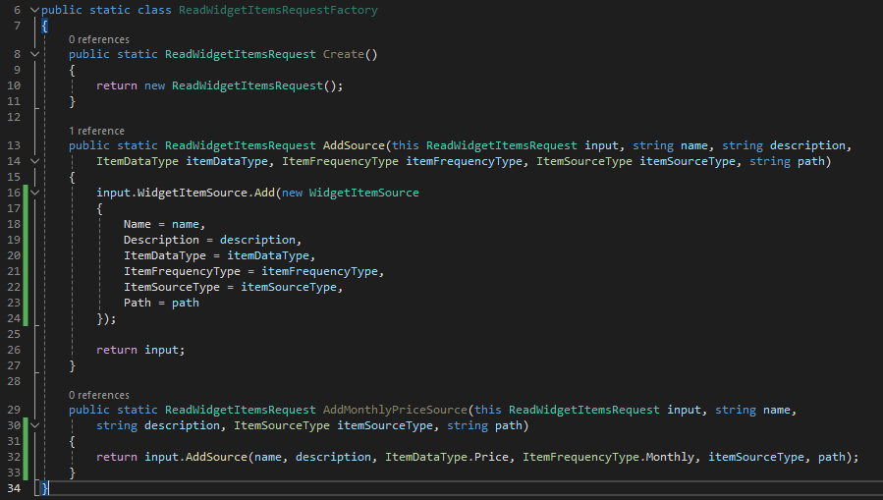
What does a RequestFactory/Builder look like?

Slide 44
How do you use the ReadWidgetItemsRequestFactory?

Slide 45
Long Running Requests, Jobs, and Returning Larger Amounts of Data

Slide 46
Why should I use streaming?
Efficiency: Streaming reduces overhead by enabling continuous communication, minimizing the need for repeated RPC calls.
Real-time updates: Bidirectional streaming facilitates immediate data exchange between client and server, ideal for real-time applications like chats or collaborative editing.
Resource optimization: Streaming allows asynchronous processing, optimizing resource usage and enhancing scalability.
Flexible communication: One-way streaming suits scenarios where data flows in one direction, while bidirectional streaming supports simultaneous data exchange.
Reduced latency: Streaming can decrease latency compared to traditional RPC calls, especially for large data transfers or frequent interactions.

Slide 47
What do the protos for 1-way streaming look like?

Slide 48
What does the implementation of 1-way streaming look like?

Slide 49
How do I use 1-way streaming?

Slide 50
What do the protos for bi-directional streaming look like?

Slide 51
What does the implementation of bi-directional streaming look like?

Slide 52
How do I use bi-directional streaming?

Slide 53
When should you use gRPC in your solution?

Slide 54
When You Should Use gRPC
High Performance and Low Latency
Microservices Architecture
Real-Time Communication
Strongly Typed Contracts
Cross-Language Compatibility
Efficient Data Serialization
Built-In Code Generation
Notes:
High Performance and Low Latency:
gRPC uses HTTP/2, which provides multiplexing, header compression, and efficient binary serialization (Protocol Buffers). This makes gRPC suitable for high-performance, low-latency communication.
Microservices Architecture:
If your application is built using a microservices architecture, gRPC can be an excellent choice for inter-service communication due to its efficiency and support for multiple programming languages.
Real-Time Communication:
gRPC supports bi-directional streaming, which is useful for real-time communication scenarios such as chat applications, live data feeds, and IoT applications.
Strongly Typed Contracts:
gRPC uses Protocol Buffers (protobuf) for defining service contracts, which provides strong typing and schema validation. This can help catch errors early in the development process.
Cross-Language Compatibility:
gRPC supports multiple programming languages, making it easier to build services that need to communicate across different technology stacks.
Efficient Data Serialization:
Protocol Buffers are more efficient than JSON or XML in terms of both size and speed, making gRPC a good choice for scenarios where bandwidth is a concern.
Built-In Code Generation:
gRPC provides tools to generate client and server code from service definitions, which can speed up development and ensure consistency between client and server implementations.

Slide 55
Example Use Cases for gRPC
Microservices Communication: Efficient communication between microservices in a distributed system.
Real-Time Applications: Applications requiring real-time data exchange, such as gaming, financial trading platforms, or live sports updates.
Cross-Platform Services: Services that need to be consumed by clients written in different programming languages.
IoT: Communication between IoT devices and backend services.

Slide 56
When Not to Use gRPC
Browser-Based Applications: gRPC is not natively supported in browsers. While there are workarounds like gRPC-Web, it might be simpler to use REST for browser-based clients.
Simple CRUD Operations: For simple CRUD operations, REST might be more straightforward and easier to implement.
Human-Readable Data: If you need human-readable data formats (e.g., for debugging or logging), JSON over REST might be more appropriate.
Notes:
Conclusion
Consider using gRPC in scenarios where performance, efficiency, and strong typing are critical. For simpler use cases or where browser compatibility is a concern, REST might be a better fit.

Slide 57
Links
gRPC
https://grpc.io/
Protobuf
https://protobuf.dev/
FluentValidation
https://fluentvalidation.net
JetBrains ReSharper
https://www.jetbrains.com/resharper/
Benchmark.NET
https://github.com/dotnet/BenchmarkDotNet/
https://www.benchmarkdotnet.org/

Slide 58
Questions?

Slide 59
Contact Info
Software Engineer
Software Engineering Capability Lead (Houston)
Email: tony.cardella@bjss.com
LinkedIn: https://www.linkedin.com/in/tcardella/
Blog: https://codegorilla.com

