Slide 1
CodeLaunch Houston 2024 – How We Did It
Tony Cardella
March 28, 2024

Slide 2
Who is Tony Cardella?
Software Engineer
Software Engineering Capability Lead (Houston)
2x BJSS CodeLaunch Team Lead
What’s my day job?
Currently working for a large Oil & Gas client on the westside of Houston as a backend software engineer.
What is my current tech stack?
.NET/C#
gRPC
PostgreSQL
Azure (for Identity)
AWS (for hosting)

Slide 3
CodeLaunch is a startup accelerator event that pairs early-stage tech startups with professional software development teams to accelerate their trajectory toward MVP, seed funding, and beyond.
– https://codelaunch.com

Slide 4
Why is BJSS Participating in CodeLaunch?
Raise BJSS brand awareness
Introduce BJSS to prospective clients
Introduce BJSS to potential future employees
Introduce people to new offerings from BJSS
Talk to Dan if you are a startup…
Opportunity to work more closely with our co-workers
Assess skill sets
Identify opportunities for upskilling BJSS employees
Provide an opportunity to work on something outside of their normal client work

Slide 5
How did we decide which company to draft?
Assemble a group of BJSS employees to help pick the company
They don’t have to all be software engineers
No restriction on their level within BJSS
Invite them all to a Slack group
CodeLaunch curates a list of 10 companies for drafting
About 48 hours out from the draft, we get the list of the companies, their pitch decks, and their “ask”
We post the materials to the Slack channel and ask everyone to review, ask questions, make comments
Setup a Slack poll for everyone in the group
Each person gets N + 1 votes
Take the top N + 1 companies in the polling and discuss one by one
Build consensus and build out a combined N + 1 draft pick list
Do the draft

Slide 6
Glydr
Free your hands & maximize your gaming potential
Our hands are often overloaded when we play games while our feet are at rest. By moving key actions to your feet with GLYDR, you’re expanding the tools at your disposal during your most intense gaming moments.
Extra buttons on controllers, keyboards, and mice don’t actually solve the problem of repetitive overuse of your hands and fingers, and often those extra buttons don’t expand your options, they simply move them around.
Whether it’s one favorite action or sixteen, every player that uses GLYDR is gaining options they can use in tandem with control schemes they already use.

Slide 7
How did we host the hack-a-thon?
We hosted the hackathon in the BJSS Houston office
TV screen for video conferencing
Extra monitors
Bring in any other hardware that will help you get the job done
Included members of Glydr in the hackathon
Smaller feedback loops
QA-lite role
Snacks and soft drinks that we usually have here in the office
Monster Energy Drinks
Tacos from Tacos A Go-Go
Bottled dihydrogen monoxide (https://www.dhmo.org/)
Sort out details like parking/office access in advance

Slide 8
How did we determine what to build?
Engage SPARCK to help with this process
Decide on a user journey
Work with the company to get everybody on the same page
Decide what to build
Put together wireframes
Begin visualizing the “what” without committing to too many details
Actively seek feedback from the company
Things to remember:
Stay on the company’s radar
Don’t let them forget that you are there
Actively seek feedback from the company
Even though this is an extremely short engagement, they are still your client.

Slide 9
What did we build?
We decided to build out the Glydr “profile” sharing user journey.
React frontend hosted on Azure Static Web App instance
Azure/C# backend hosted on an Azure App Service instance
Azure Storage Account (images and data serialized to json blob containers)
2x custom domain names (1 for frontend and 1 for backend)
2x GitHub repositories
2x GitHub Action CI/CD pipelines (frontend/backend) including deployment

Slide 10
What did we do at CodeLaunch: The Event?

Slide 11
What did we do after CodeLaunch: The Event?
Send a thank you to everyone who participated or helped pull off the event.
BJSS Dev team members (Usama, Lijo, Indra)
Glydr (Peter, Rick, John)
SPARCK team members (Anna & Leonie)
Taco Go-fer and Connection-Maker (Dan)
BJSS management for believing in us and for letting us use the clubhouse (Lilia & Mark)
Important meetings to hold after the event
BJSS internal retro/post-mortem
Capture lessons learned from the dev team itself
360 degree review
What did we do good
Identify areas we can improve
BJSS-Glydr retro/post-mortem
Capture lessons learned from Glydr
Identify areas we can improve

Slide 12
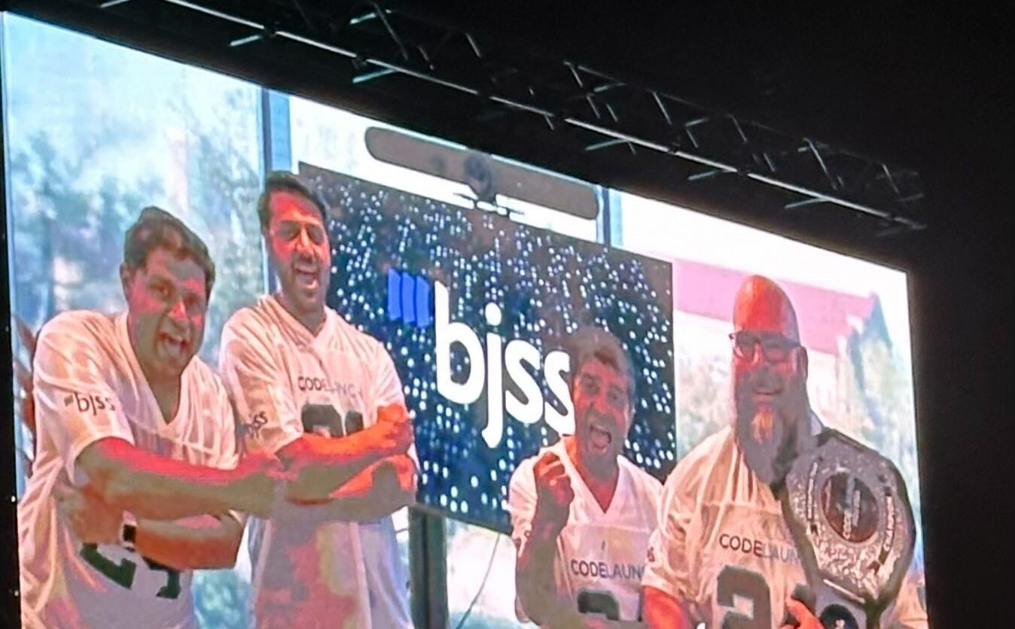
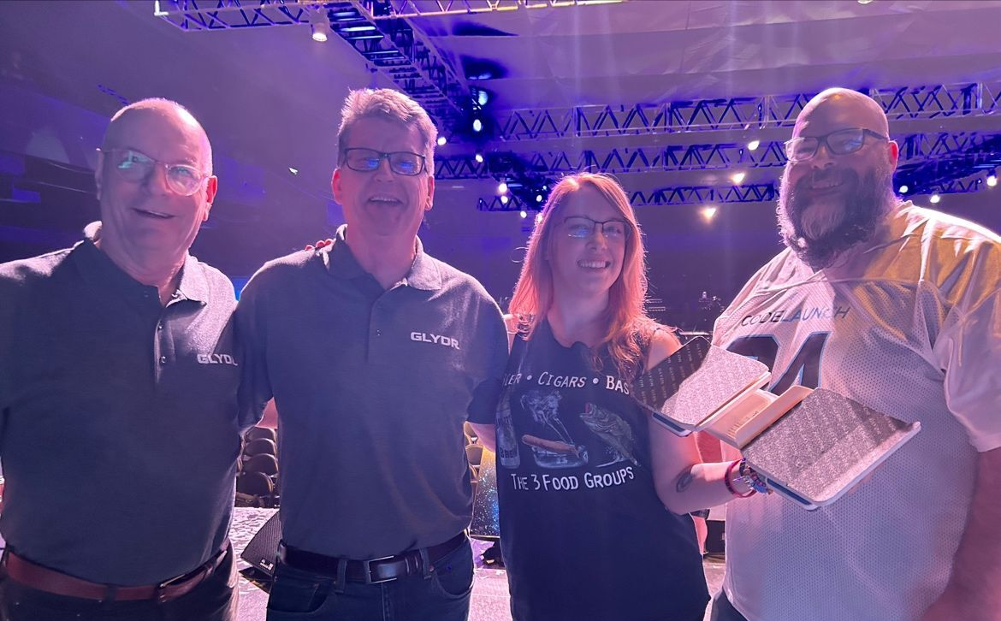
Any final thoughts?
Decide what your company wants out of CodeLaunch
Winning the tech battle vs winning the popularity contest
Draft a company that is open to new ideas, but is decisive
Clear the calendars of the 4 hackathon team members

Slide 13
Questions?

Slide 14
Contact Info
Software Engineer / Software Engineering Capability Lead (Houston)
Email: tony.cardella@bjss.com
LinkedIn: https://www.linkedin.com/in/tcardella/
Blog: https://codegorilla.com

